Slide 1
Finding the best place to live in Seattle
By: Ahmed Sherief
Feb. 2020

Slide 2
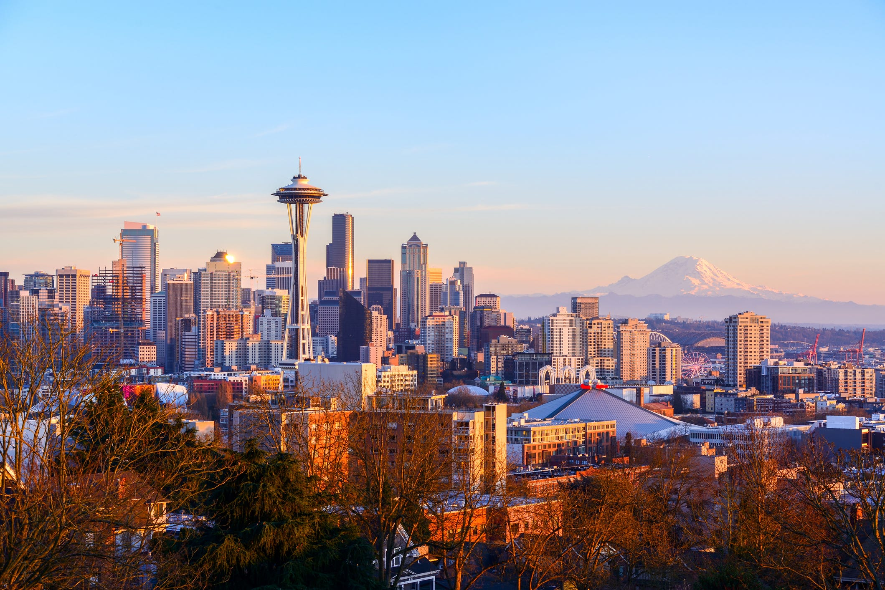

Slide 3
The objective of this project
- is to analyze data and find the best place of living in the city to live near to all services such as hospitals, restraints, bus station, metro café, parking and gardens……etc.
- using data science methodology and machine learning technique like clustering. We have to find the best cluster with the largest number of services

Slide 4
Data
List of neighborhoods in Seattle. We have to scrape it from (Category:Neighborhoods in Seattle - Wikipedia)
2. Latitude and longitude coordinates of this neighborhoods. We will get it using Python geocoder package.
3. Venue data, and we will use it to perform clustering on the neighborhoods. And we will use foursquare API to get the venue.

Slide 5
Methodology
•Web scraping Wikipedia page for neighborhoods list
•Get latitude and longitude coordinates using Geocoder
•Use Foursquare API to get venue data
•Analyze the data and normalize it
•Perform clustering on the data by using k-means clustering
•Visualize the clusters in a map using Folium

Slide 6
Results
The results from the k-means clustering show that we can categorize the neighborhoods into 3 clusters based on the number of venues:
• Cluster 0: Neighborhoods with large number of Venues.
• Cluster 1: Neighborhoods with the lowest number of existence of venues.
• Cluster 2: Neighborhoods with moderate concentration of venues.

Slide 7
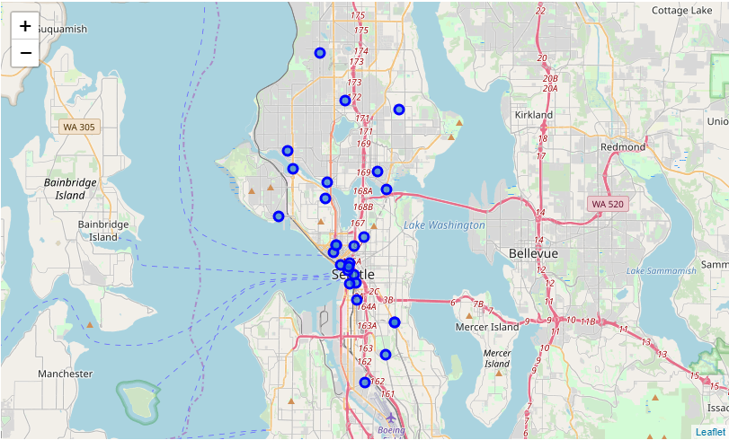

Slide 8
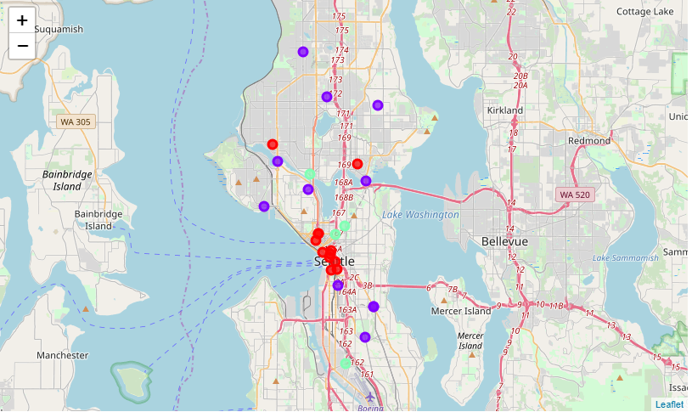

Slide 9
Discussion
From the Results section, most of the neighborhoods with the large number of venues are in the central area of Seattle, with the highest number in cluster o and moderate number in cluster 2. On the other hand, cluster 1 has very low number of venues in the neighborhoods.
This represent the best place of living in the city to live near to all services such as hospitals, restraints, bus station, metro café, parking and gardens……etc.
The best cluster is (cluster 0) based on the high number of venues. then (cluster 2), and be careful living in (cluster 1) will be bad for you and your family because there well be few number of services compared to the other two clusters

Slide 10
Conclusion
As a result, people are turning to big cities to start a business or work. For this reason, people can achieve better outcomes through their access to the platforms where such information is provided.
Not only for investors but also city managers can manage the city more regularly by using similar data analysis types or platforms.

Slide 11
Thanks

